Slide 1

PYTHON MEGA PROJECT-1: PYTHON FOR COMPUTER SCIENCE AND DATA SCIENCE: AN INTRODUCTORY MEGA PROJECT
PROJECT-TITLE:
2020 COVID-19 GLOBAL Impact VISUALIZER
PRESENTED BY: PRAMODH NARAIN
Channel: the_real_pcc
DEPARTMENT: COMPUTER SCIENCE AND ENGINEERING (DATA SCIENCE)
YEAR: 2025

Slide 2
ACKNOWLEDGEMENT
I sincerely express my gratitude to my parents who were my supporting pillars during the development of this project.
I made sure that I was sincerely dedicated to this project along with their encouragement.

Slide 3
Project abstract
Python’s Versatility: Key role in Computer Science & Data Science.
Comprehensive Breakdown of Python fundamentals and applications.
Hands-on Demonstration for real-world learning
Stepping stone to AI and Big Data Analytics.

Slide 4

Introduction
Evolution of Python: Created by Guido van Rossum in 1991.
Why Python?: Readability, vast libraries, cross-platform compatibility.
Comparison with Other Languages: Efficiency, ease of learning, versatility.

Slide 5
Python for computer science
Software Development: Web, desktop, and game development.
Artificial Intelligence: TensorFlow, Scikit-learn, NLP.
Automation: File management, web scraping, scripting.
Data Structures & Algorithms: Key for problem-solving.

Slide 6
Python for data science
Key Libraries: Pandas, NumPy, Matplotlib, Seaborn, Scikit-learn.
Data Preprocessing & Cleaning: Handling missing values, normalization.
Visualization Techniques: Charts, histograms, heatmaps.
Real-World Applications: Finance, healthcare, marketing.

Slide 7

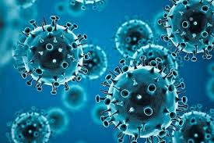
Project overview
Objective: Analyzing and visualizing COVID-19 data.
Data Source: Kaggle COVID-19 dataset.
Metrics Covered: Cases, deaths, recoveries, active cases, trends.

Slide 8
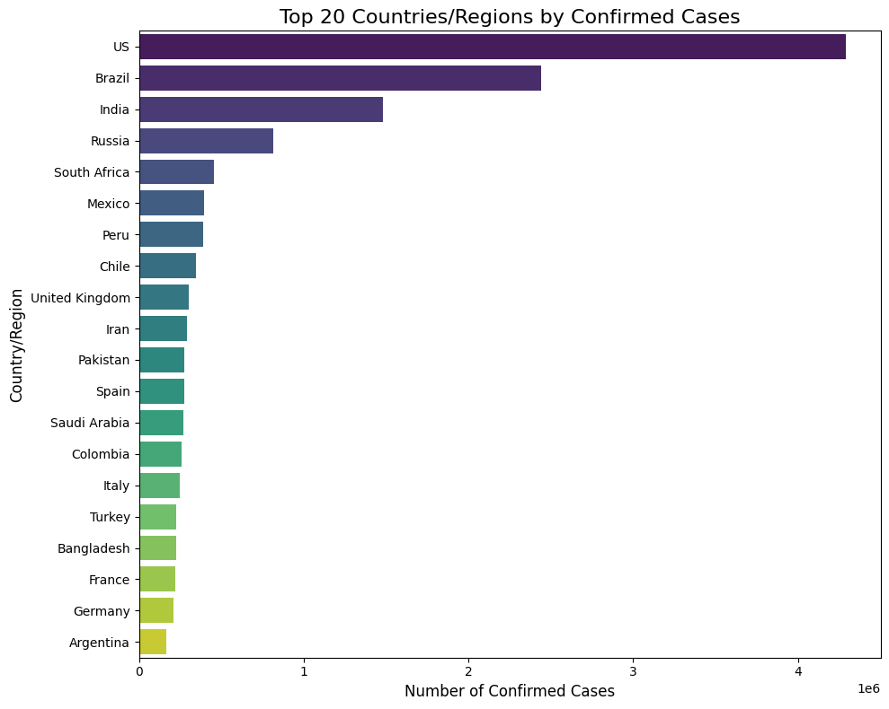
NEW CASES – DAILY CONFIRMED CASES
Tracking daily new confirmed COVID-19 cases.
Python Script used for Trend Analysis.
Graphical Representation of Daily New Cases.

Slide 9
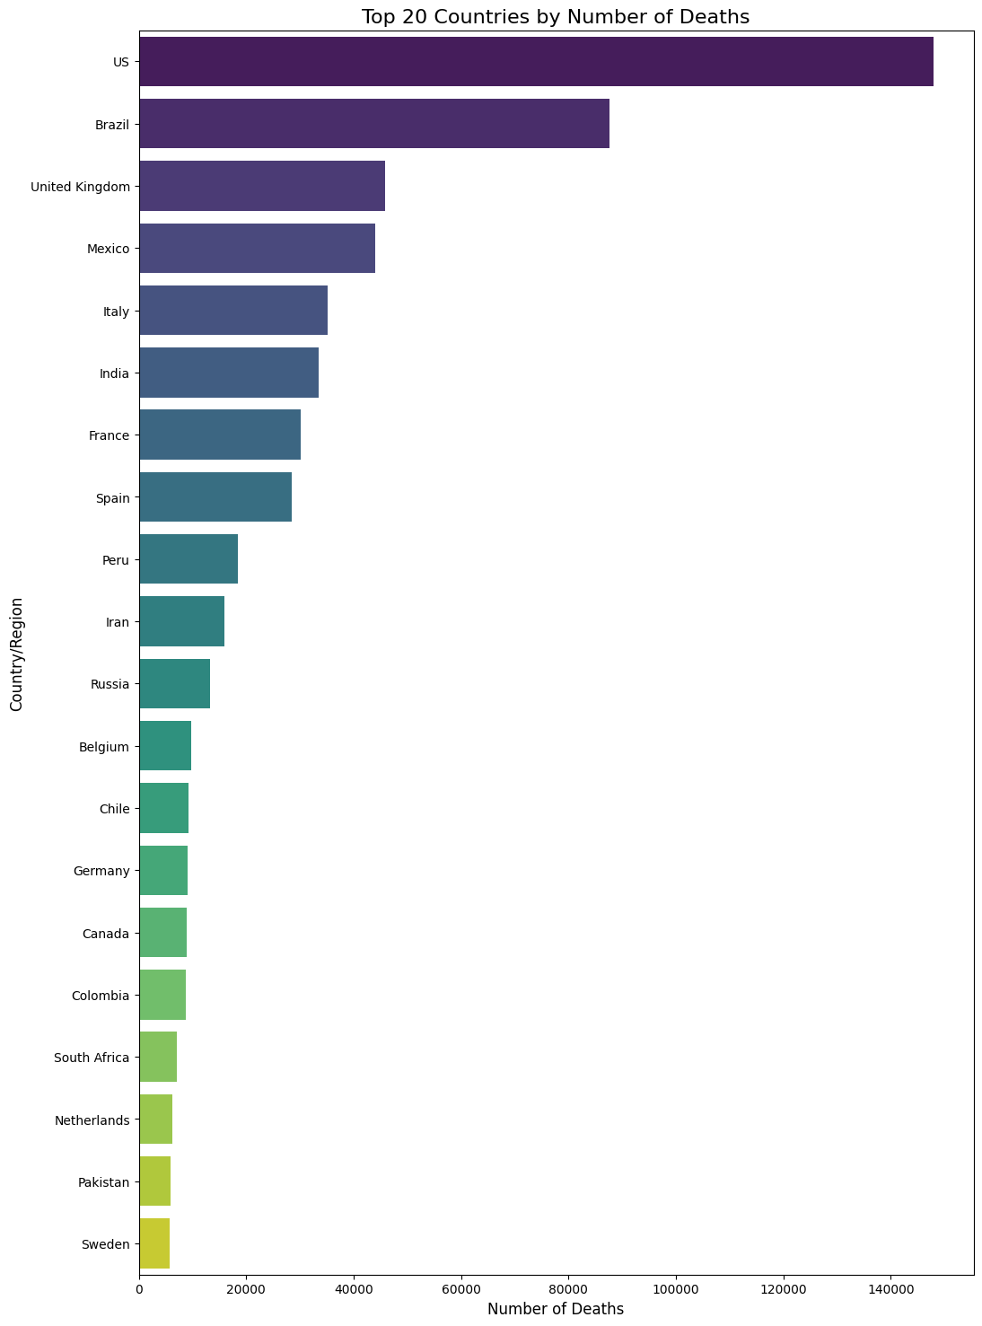
NEW DEATHS – DAILY COVID-19 DEATHS
Tracking daily reported deaths due to COVID-19.
Python script used for analysis.
Graphical representation using Matplotlib & Seaborn.

Slide 10
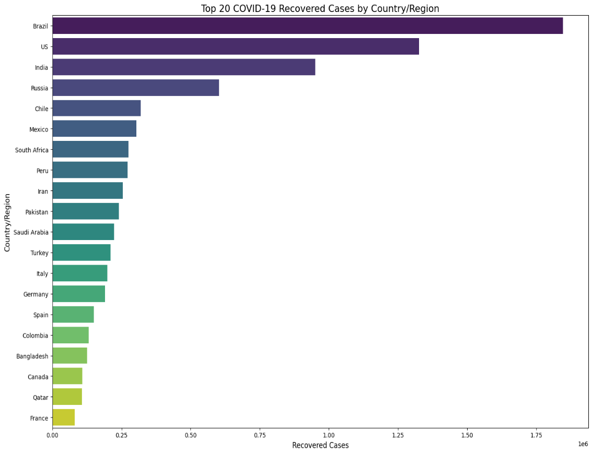
New recoveries – daily covid-19 recoveries
Tracking daily recovered COVID-19 patients.
Python script for visualizing recovery trends.
Graphical output showcasing recovery patterns.

Slide 11
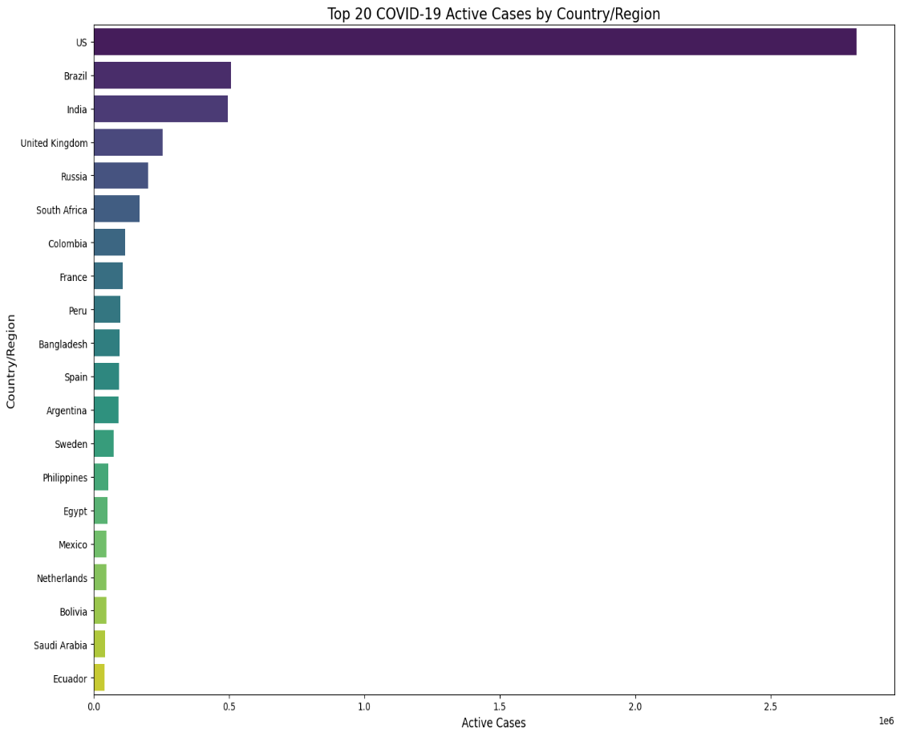
ACTIVE CASEs by country/region
Tracking active COVID-19 cases by country and region.
Comparative analysis of countries with highest active cases.
Graphical trends to show ongoing case status.

Slide 12
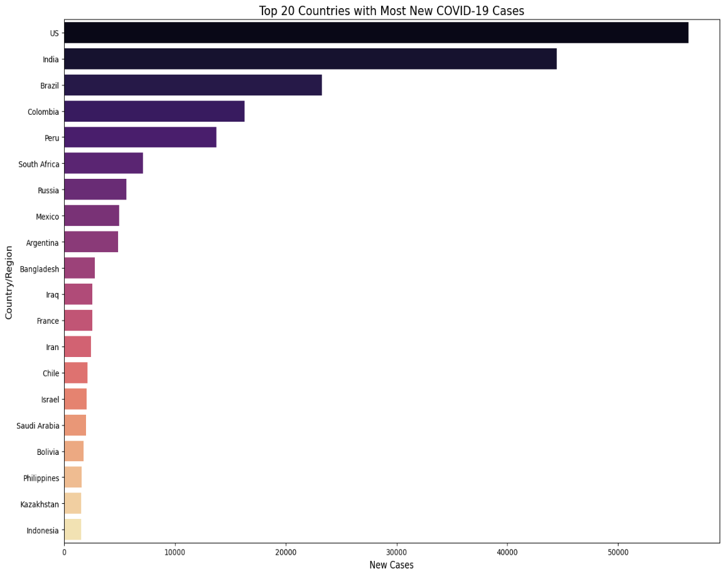
Daily new covid-19 cases
Tracking the daily trends of new COVID-19 cases globally.
Python based visualization for trend comparison.
Graphical insights for effective monitoring.

Slide 13
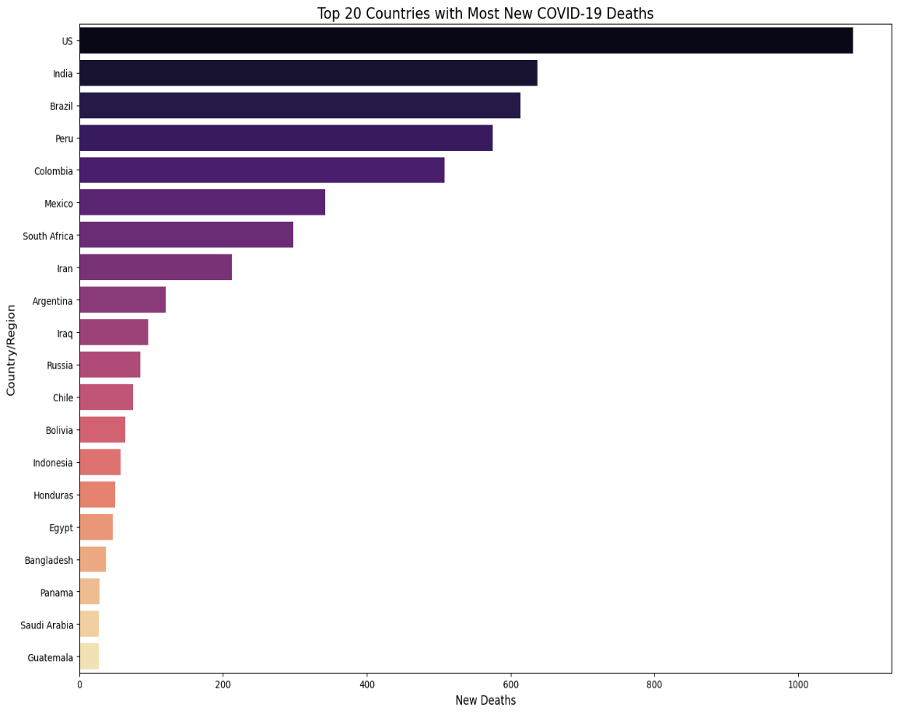
Daily new deaths due to covid-19
Tracking daily new deaths reported due to COVID-19.
Python script used for analysis.
Graphical representation using Matplotlib & Seaborn.

Slide 14
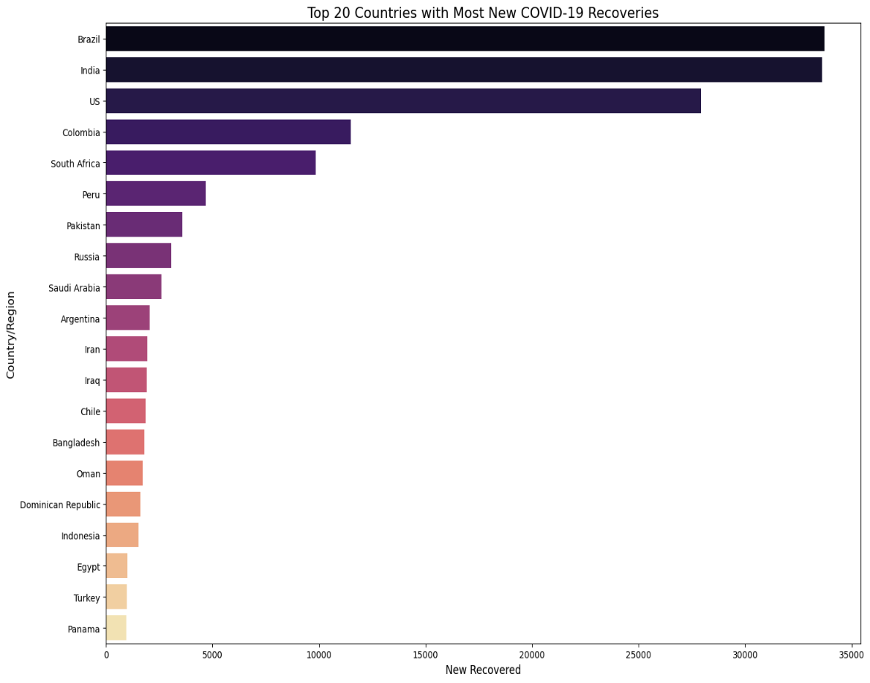
Daily New Recoveries
Tracking daily new recoveries from COVID-19.
Python script used for analysis.
Graphical representation using Matplotlib & Seaborn.

Slide 15
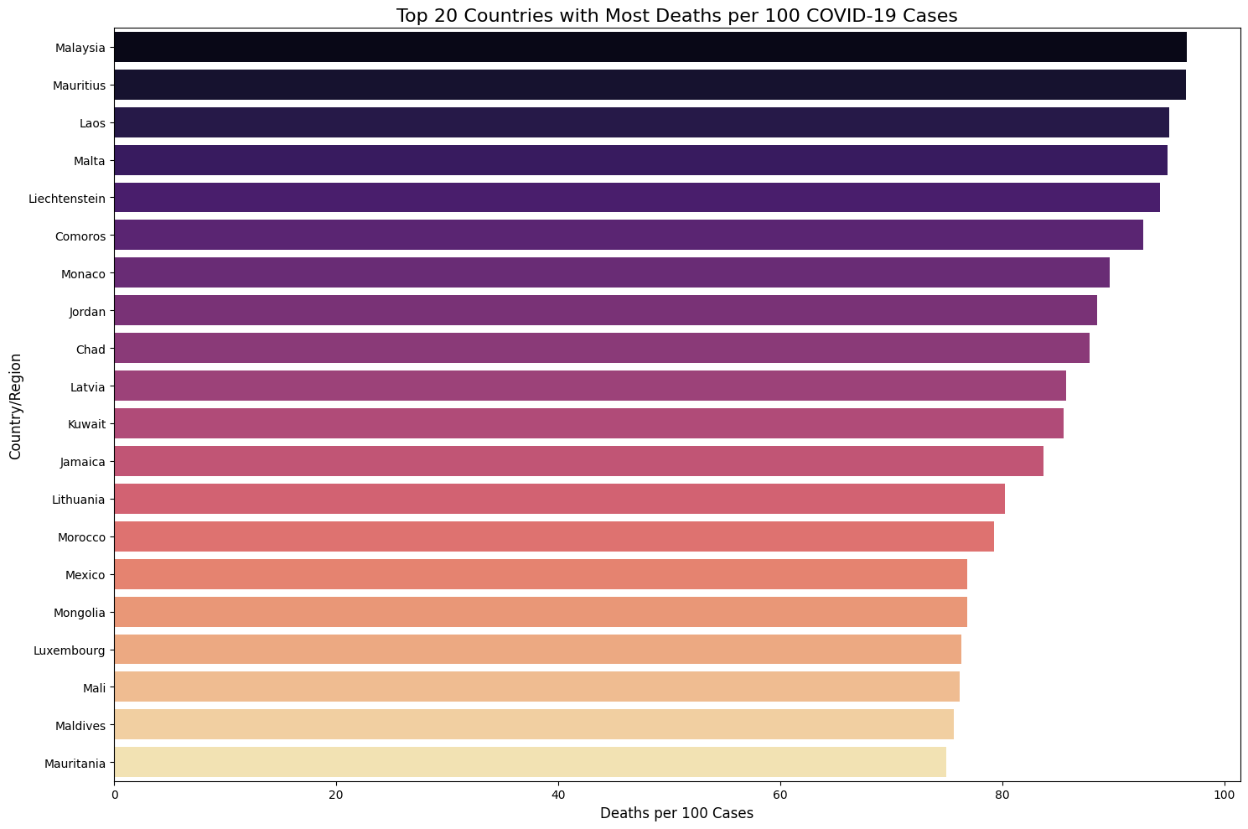
Deaths per 100 cases – the proportion of deaths per 100 confirmed cases
Analysis of the proportion of deaths per 100 confirmed cases.
Python script used for analysis.
Graphical representation using Matplotlib & Seaborn

Slide 16
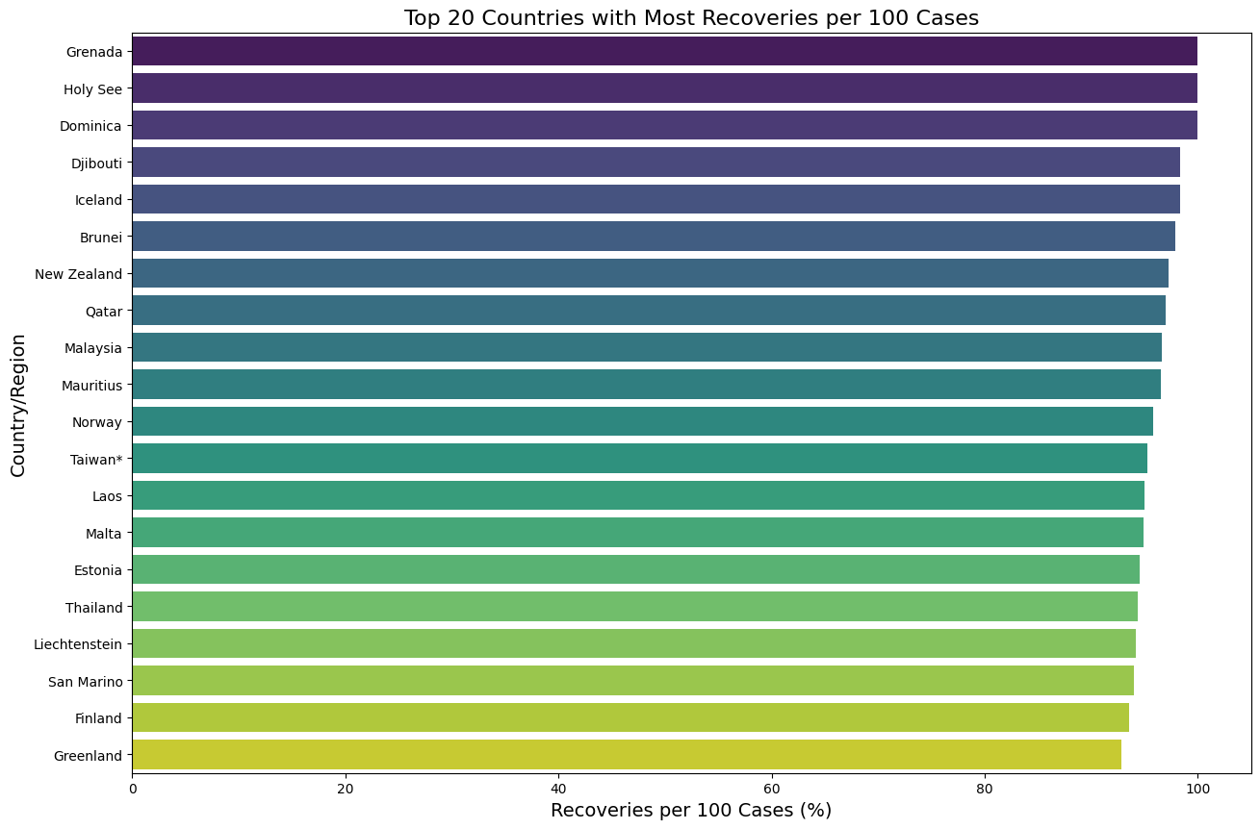
Recoveries per 100 cases – the proportion of recoveries per 100 confirmed cases.
Analysis of the proportion of recoveries per 100 confirmed cases.
Python script used for analysis.
Graphical representation using Matplotlib & Seaborn.

Slide 17

Summary of key covid-19 data across countries
A summary of key COVID-19 data across multiple countries.
Python script used for analysis.
Graphical representation using Matplotlib & Seaborn.

Slide 18
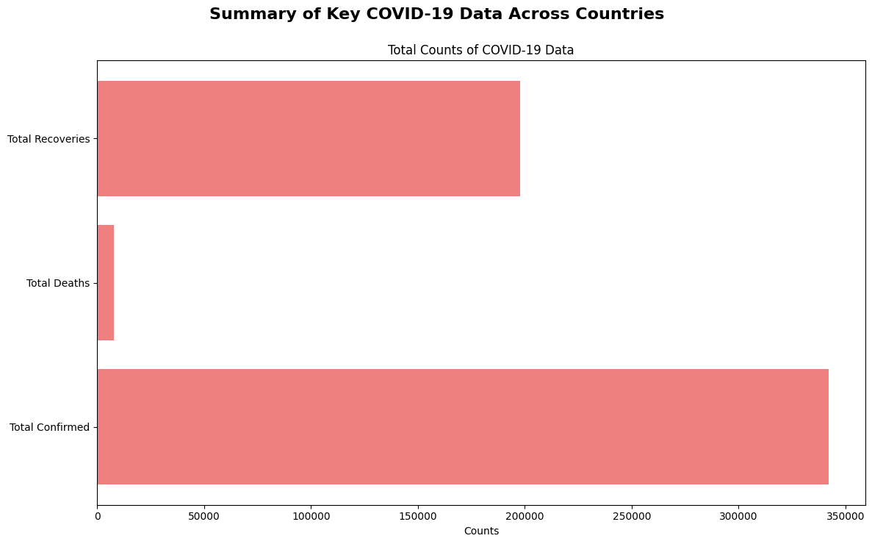
OUTPUT-1 – TOTAL COUNTS OF COVID-19 DATA
Overview of the total counts for key COVID-19 data metrics.
Python Script used for analysis.
Graphical representation using Matplotlib & Seaborn.

Slide 19
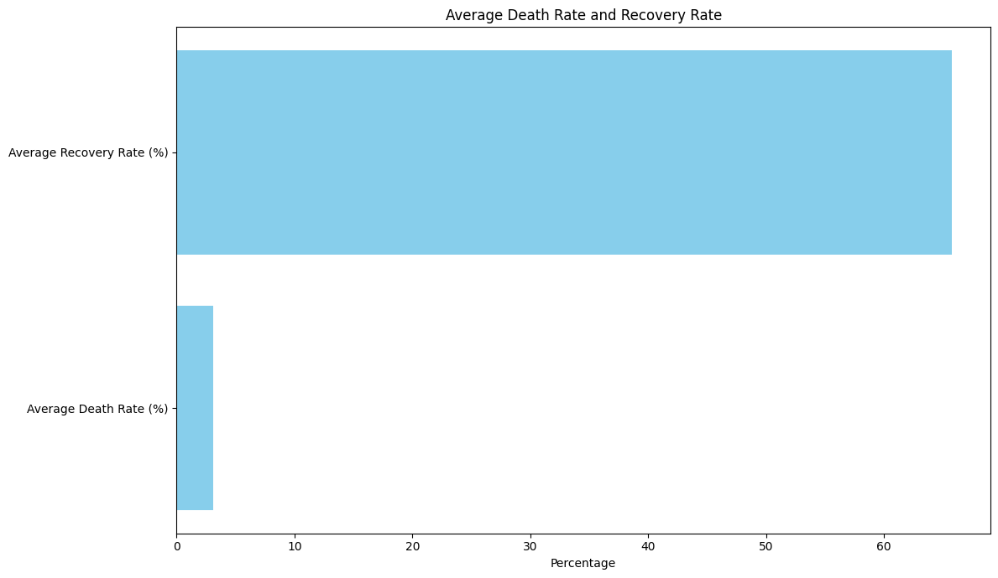
OUTPUT-2 – average death rate and recovery rate
Analysis of the average death rate and recovery rate across all countries.
Python script used for analysis.
Graphical representation using Matplotlib & Seaborn.

Slide 20
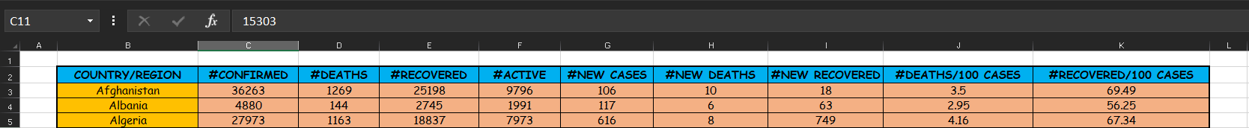
SHEET-1 – Kaggle_country_wise_latest
The most up-to-date and comprehensive dataset of COVID-19 statistics for various countries and regions.
Key metrics: Includes confirmed cases, deaths, recoveries, active cases, and more.

Slide 21
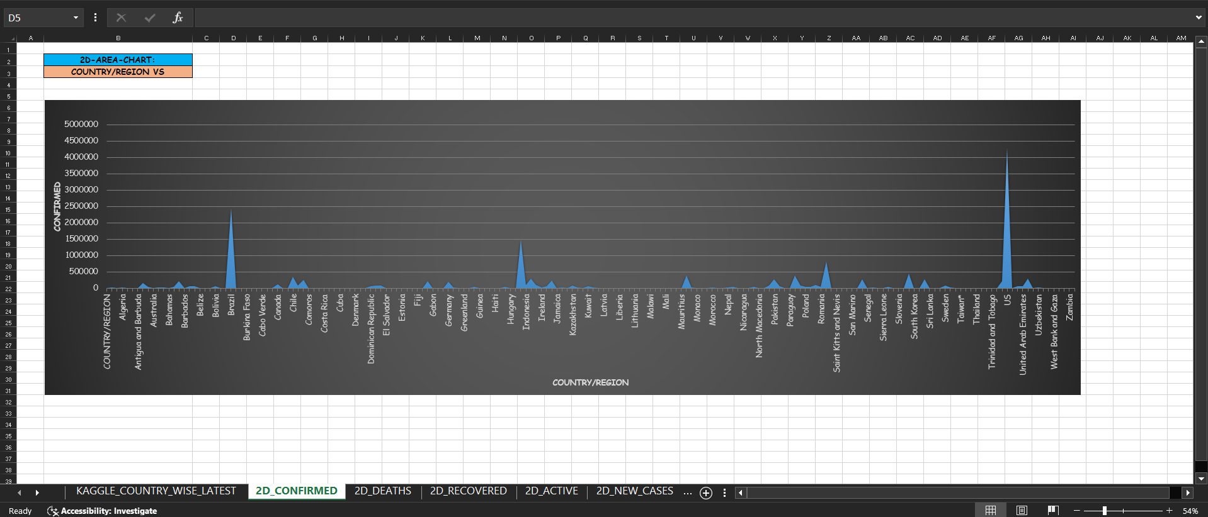
SHEET-2 – 2d_confirmed
A 2D Area Chart representing the relationship between Country/Region and Confirmed COVID-19 Cases.
Visualizing the distribution of confirmed cases across various global regions.

Slide 22
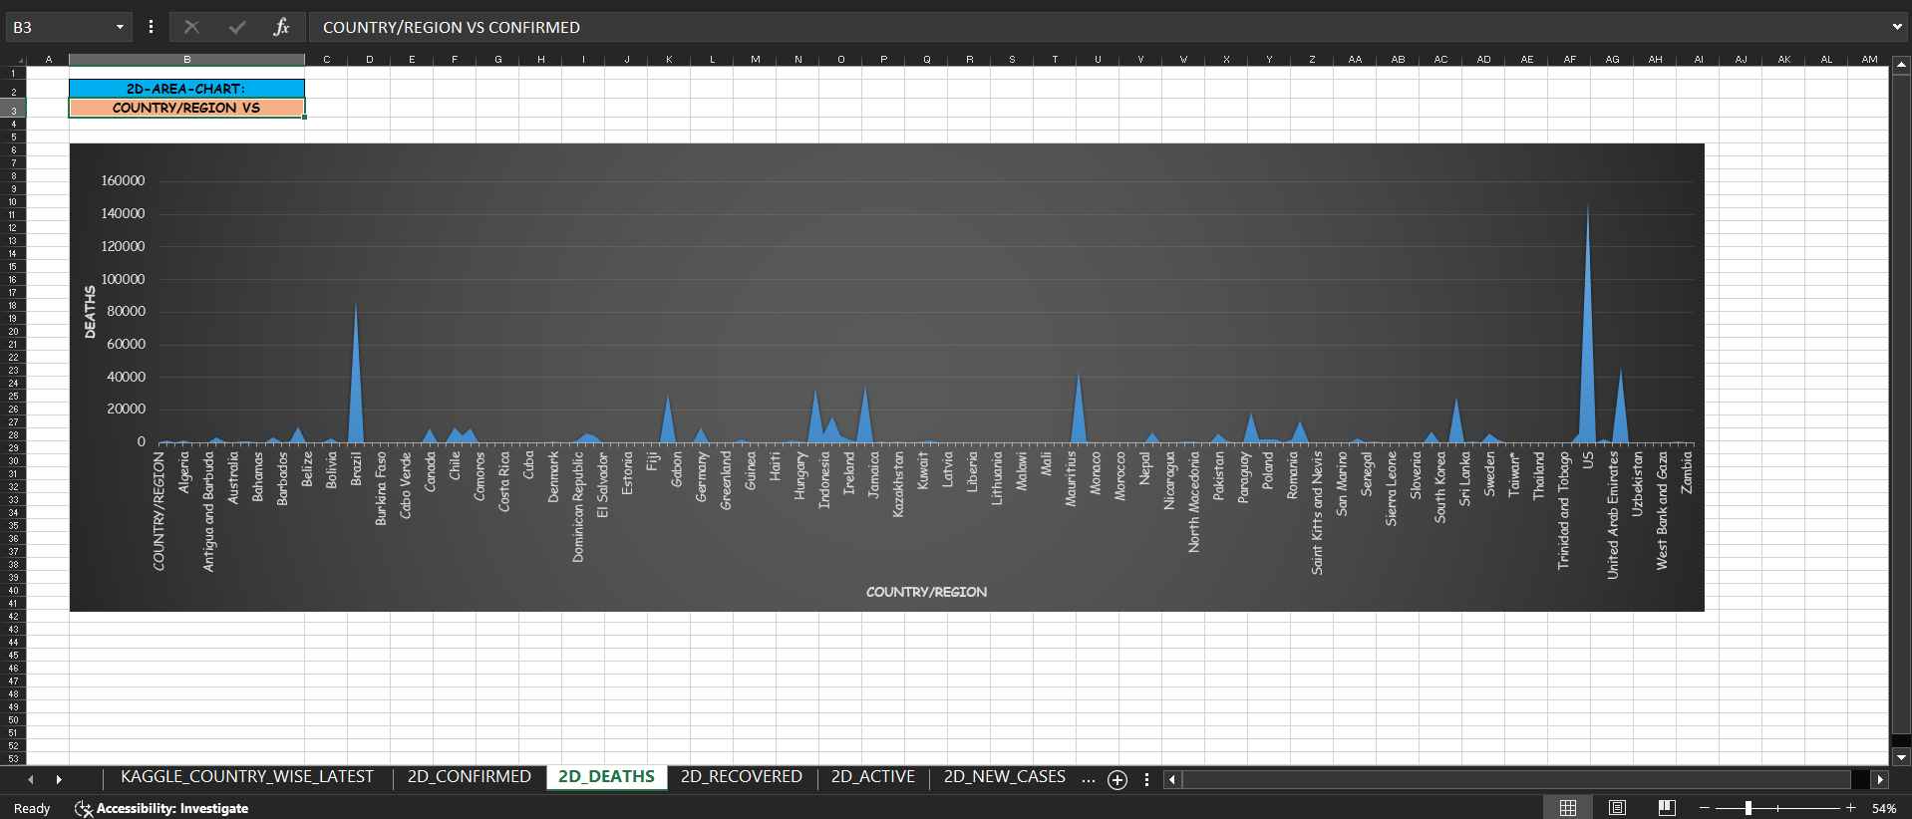
SHEET-3 – 2d_deaths
A 2D Area Chart comparing Country/Region with Total Deaths due to COVID-19.
Highlighting the mortality rate in different countries.

Slide 23
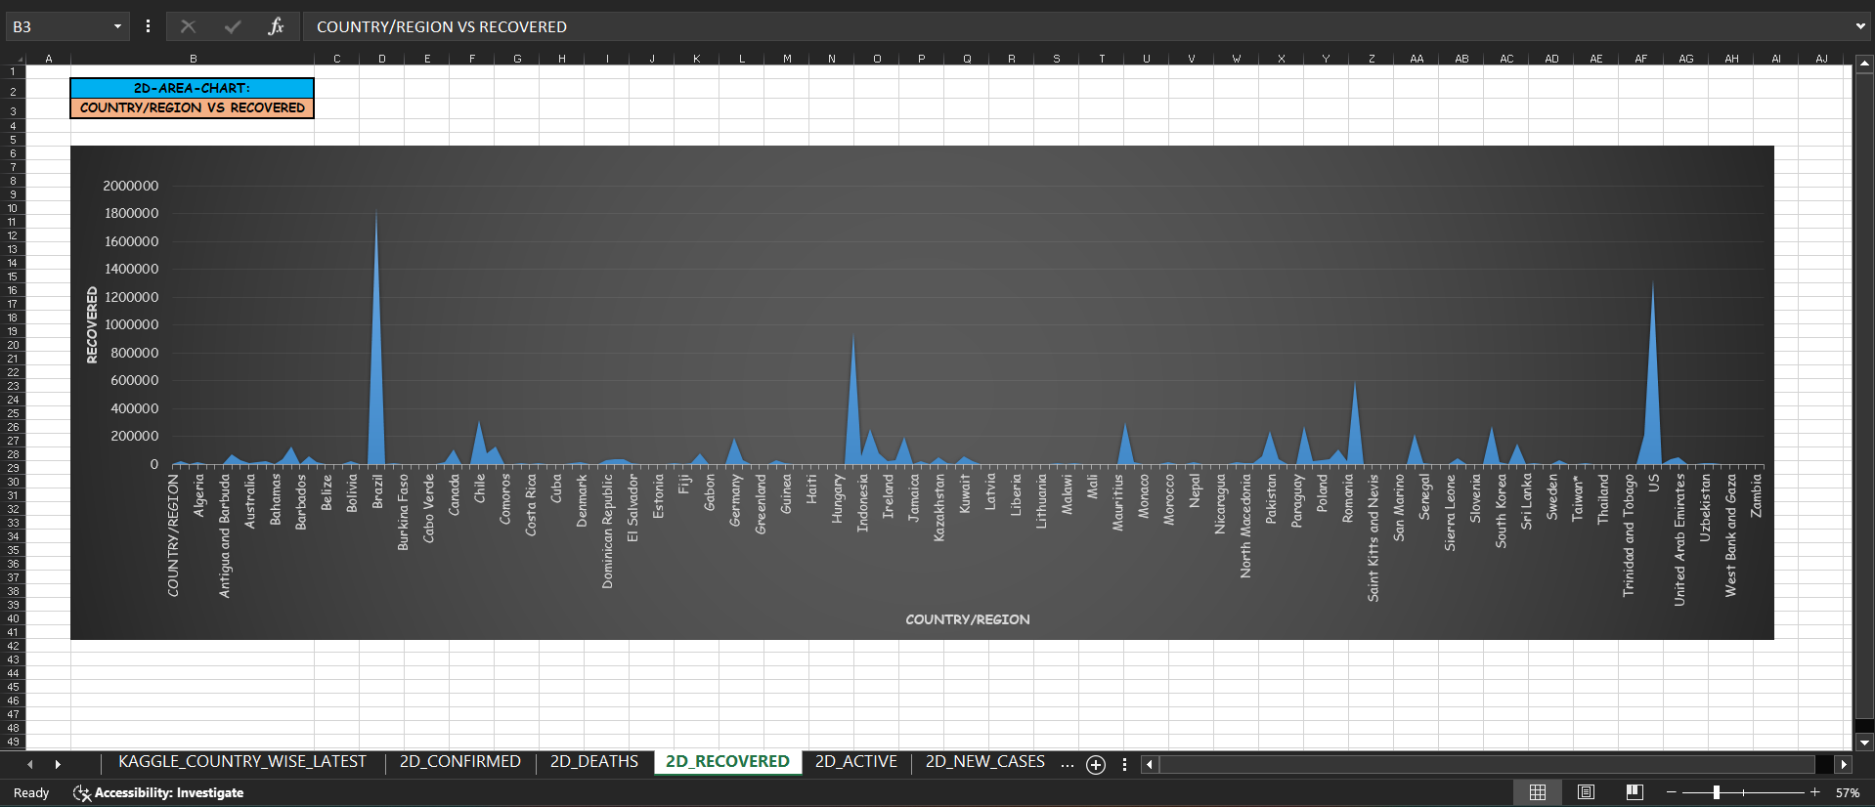
SHEET-4 – 2d_recovered
A 2D Area Chart illustrating Country/Region vs. Total Recovered COVID-19 Cases.
Providing a clear view of recovery trends across the globe.

Slide 24
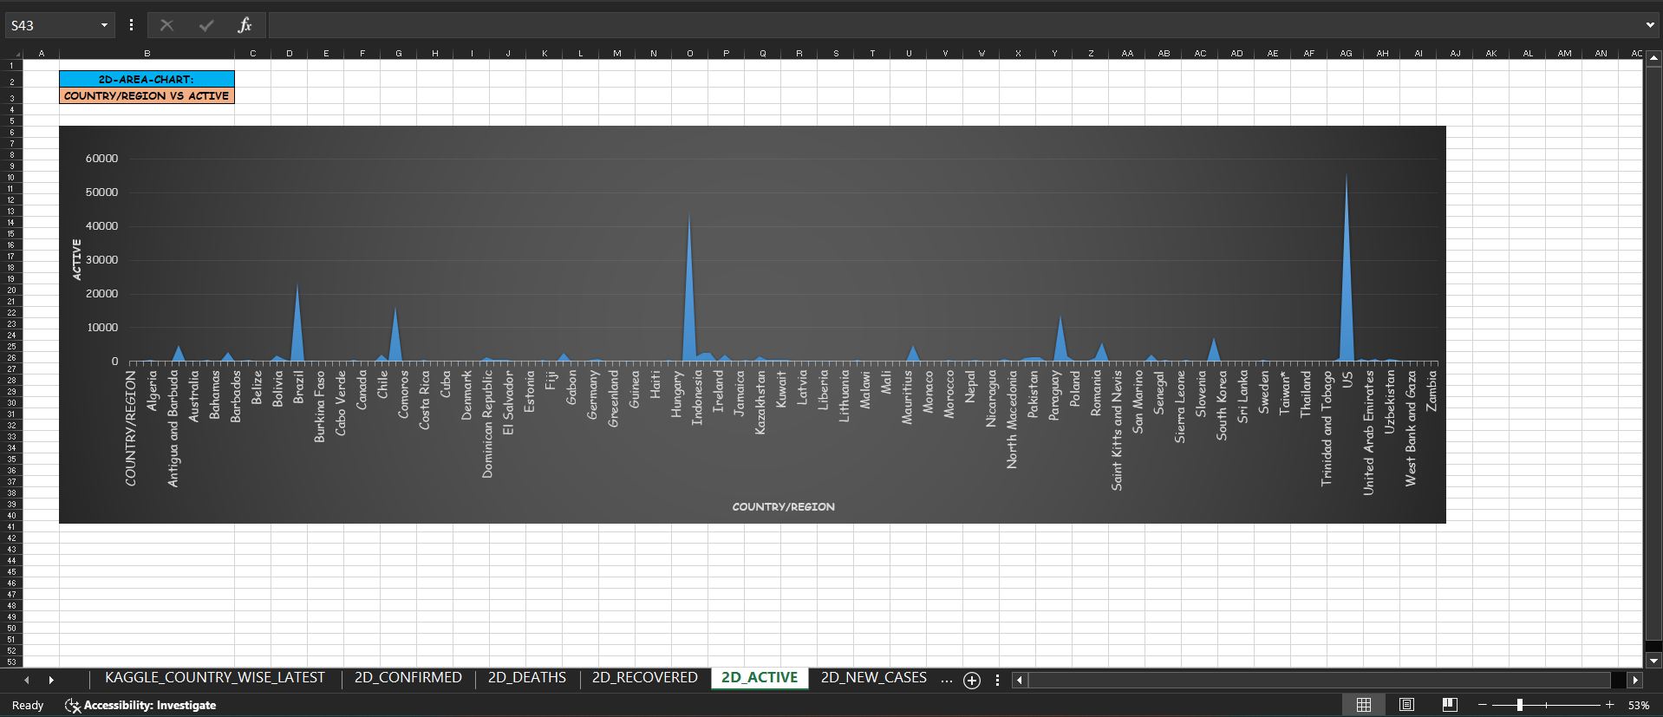
SHEET-5 – 2d_active
A 2D Area Chart tracking Country/Region in relation to Active COVID-19 Cases.
Crucial for understanding the current load of active infections globally.

Slide 25
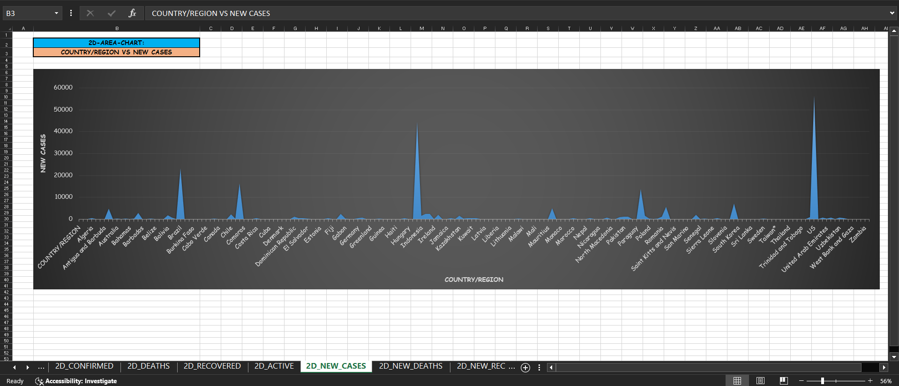
SHEET-6 – 2d_new_cases
A 2D Area Chart representing Country/Region against New COVID-19 Cases.
Shows the growth of new infections and identifies trends across countries.

Slide 26
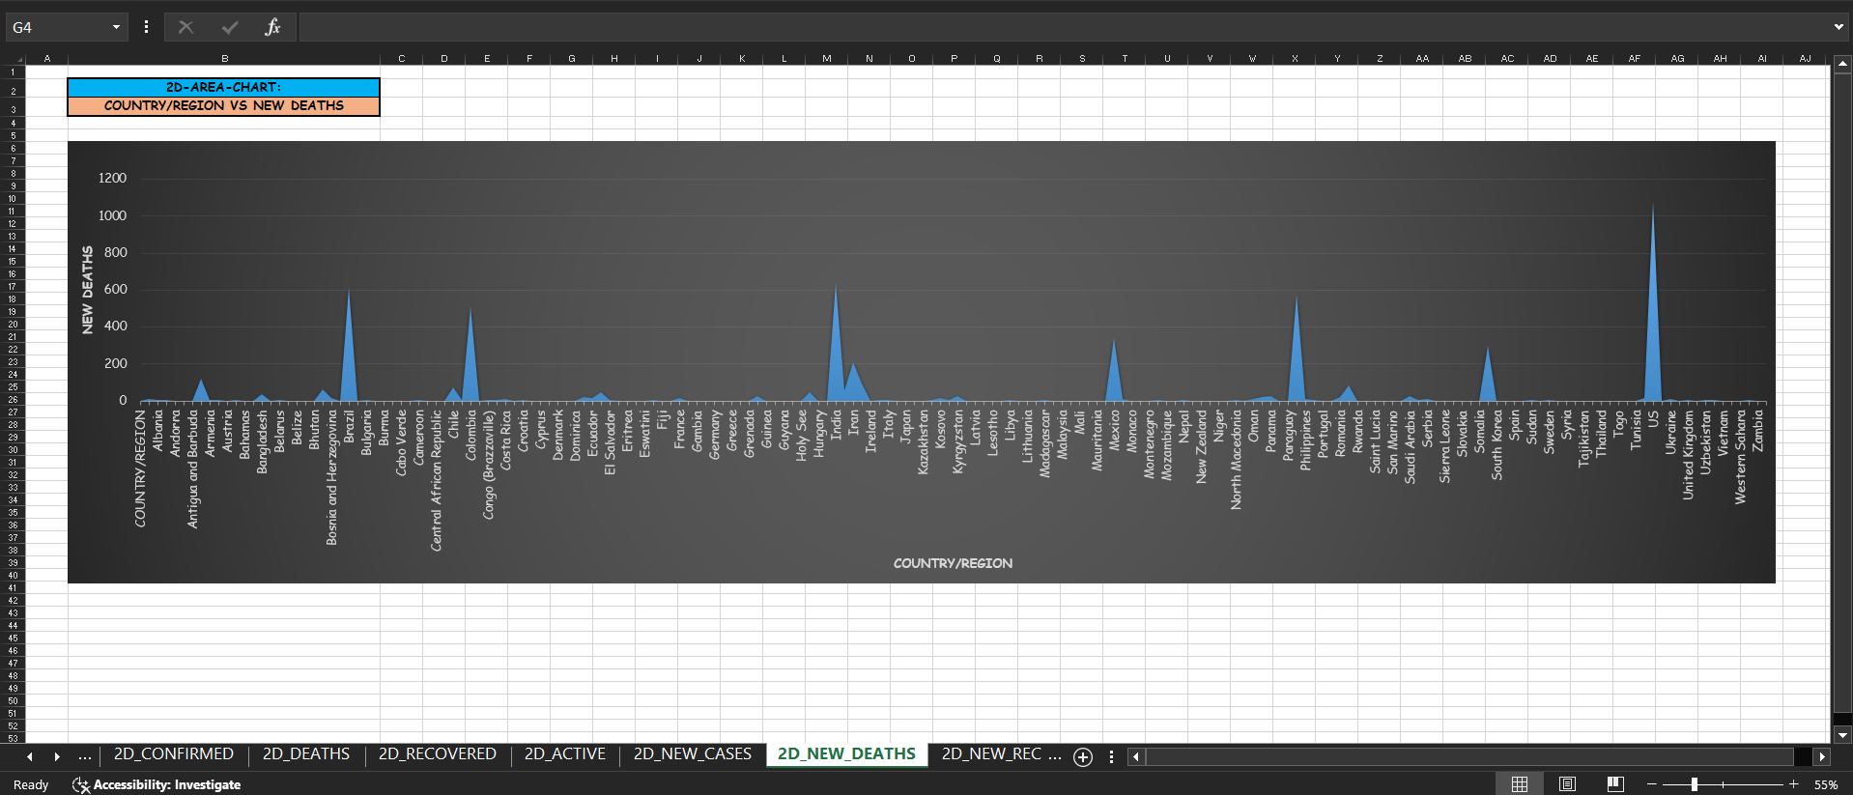
SHEET-7 – 2d_new_deaths
A 2D Area Chart visualizing Country/Region in relation to New Deaths due to COVID-19.
Focuses on the daily/periodic rise in deaths across different regions.

Slide 27
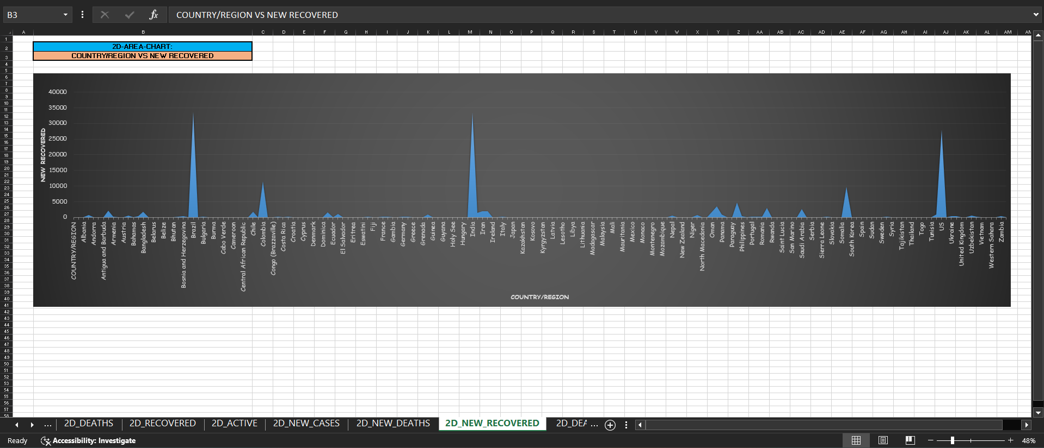
SHEET-8 – 2d_new_recovered
A 2D Area Chart comparing Country/Region with New Recoveries after COVID-19 attack.
Highlights the pace of recovery in different regions as new cases decrease.

Slide 28
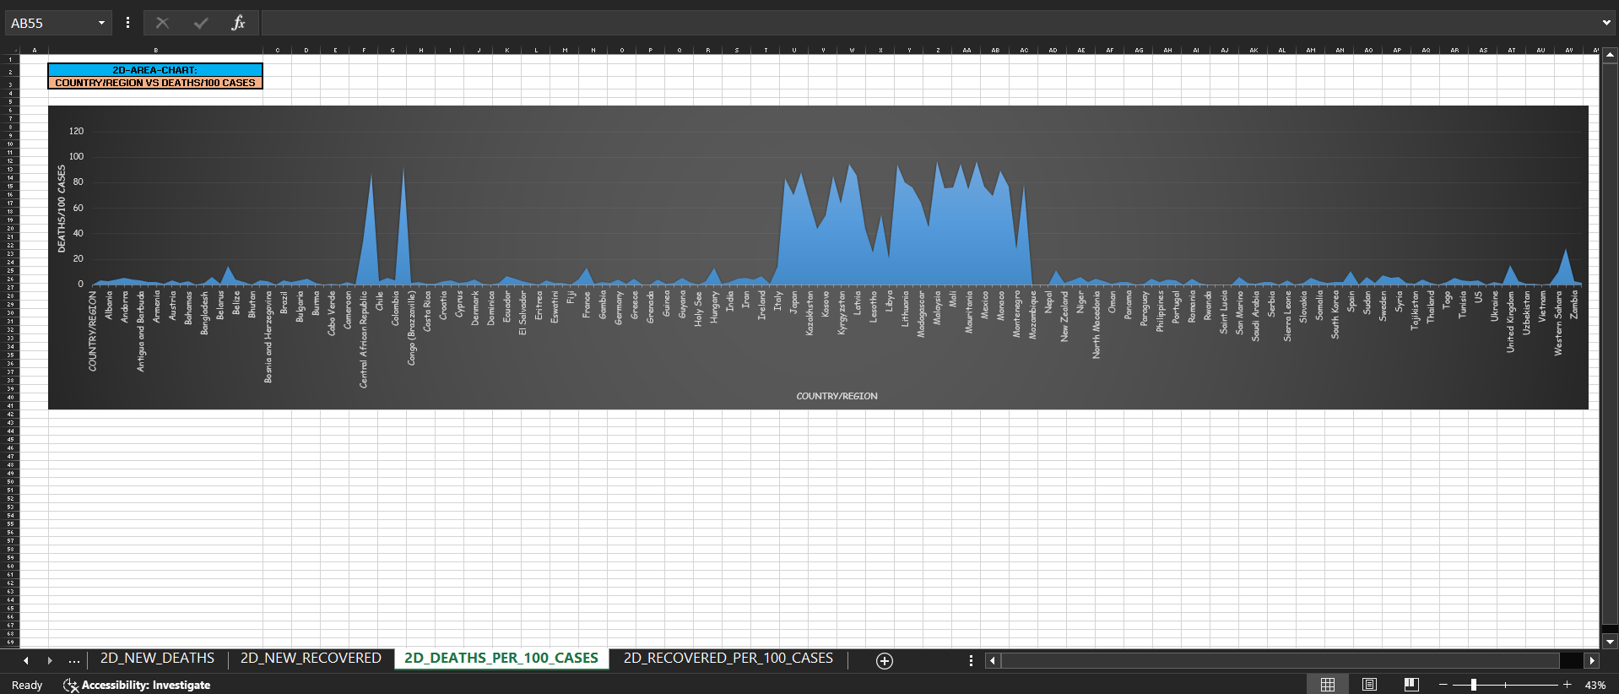
Sheet-9 – 2D_deaths_per_100_cases
A 2D Area Chart comparing Country/Region with Deaths per 100 COVID-19 Cases.
Helps understand the mortality rate in relation to confirmed cases across regions.

Slide 29
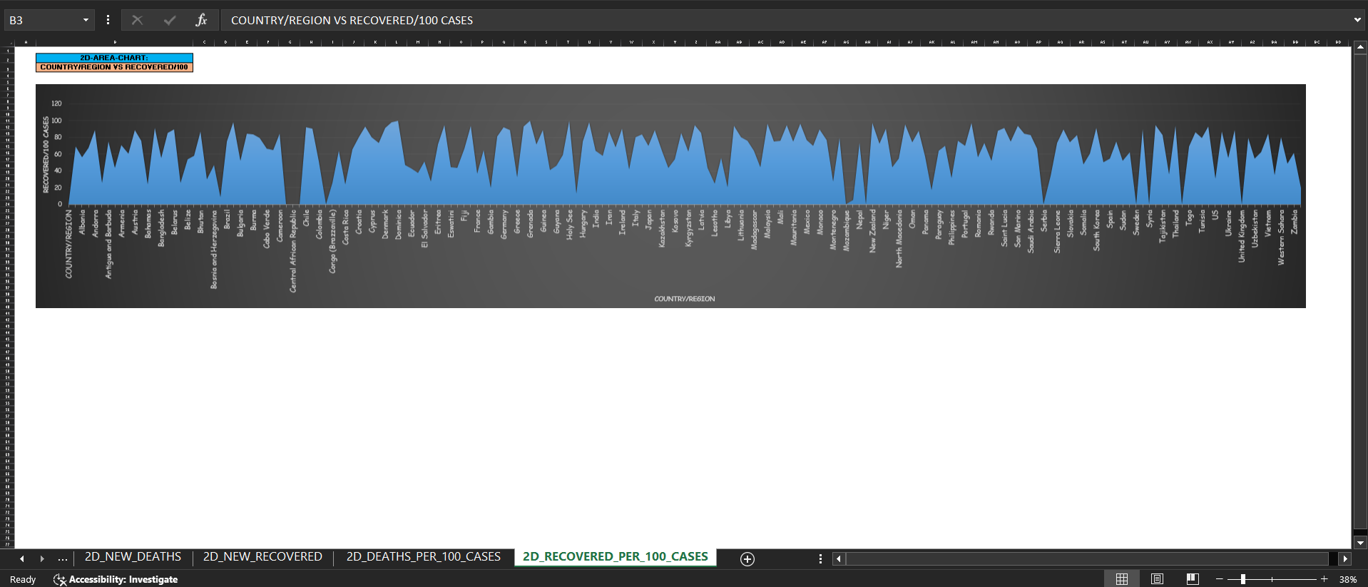
Sheet-10 – 2D_recovered_per_100_cases
A 2D Area Chart showing Country/Region vs. Recoveries per 100 COVID-19 Cases.
Analyzes recovery rate as a percentage of confirmed cases across countries.

Slide 30
COVID-19: TRENDS, INSIGHTS & THE ROAD AHEAD
Insights: Rising cases, varying regional impact, improving recovery rates.
Trends: Vaccination success, seasonal surges, shifting case-recovery patterns.
Future: More vaccinations, localized outbreaks, long-term endemic management.
Data-driven decisions for a safer future!

Slide 31
Conclusion & future scope
Key Findings from Data Analysis.
Recommendations for Public Health & Preparedness.
Future Research in AI, Deep Learning & Big Data Analytics.

Slide 32

Bibliography/references
Data Source: Kaggle COVID-19 dataset.
Thanks to Kaggle for providing open-source data that made this project possible.
Reference Links:
https://www.kaggle.com/datasets/imdevskp/corona-virus-report?resource=download

Slide 33

THE JOURNEY CONTINUES
Stay tuned for more innovative
and exciting projects!
Let’s continue exploring and building together!
COMING SOON!

Slide 34
Endless gratitude
Dedicated to My Parents for their unwavering support.
Their Encouragement & Love helped me complete this project.
Thank You for Being My Pillars of Strength!

